Slide 1
Grimsley High School IB Programme Open House

Slide 2
What is IB?
-Founded in 1968 in Geneva, Switzerland
-Over 4000 IB schools worldwide
Mission Statement:
“...to develop inquiring, knowledgeable and caring young people who help to create a better and more peaceful world through intercultural understanding and respect…to encourage students across the world to become active, compassionate and lifelong learners who understand that other people, with their differences, can also be right.”

Slide 3
What is IB?
IB learner profile
The IB learner profile is the IB mission statement translated into a set of learning outcomes for the 21st century.
As IB learners we strive to be:
• inquirers
• knowledgeable
• thinkers
• communicators
• principled
• open-minded
• caring
• risk-takers
• balanced
• reflective

Slide 4
IB Diploma Programme requirements
Six Academic Areas
-Students must take one course from each of the six subject areas (students can choose to forgo the arts and take two courses in another subject area)
-Three courses (no more than four) must be taken at the Higher Level (HL)
-The other courses must be taken at the Standard Level (SL)

Slide 5
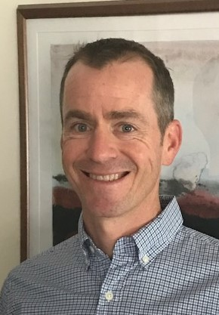
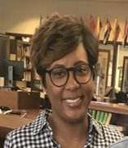
Support System-Who, What, Where?
Beth Marsh,
IB Counselor
Ben Barnard,
IB Coordinator
EE Coordinator
Erica Hunt,
CAS Coordinator
-Schedule Changes
-Request a Conference
-Having trouble with deadlines
-General support
-College/Scholarship Applications
-PowerSchool Help
-Social/Emotional Needs
-IB Diploma Requirements
-Questions about IB
-Having trouble with deadlines
-General support
-IB and AP Exam Registration
-IBIS/Managebac Login
-Schedule Requests over Summer
-Extended Essay & research
-CAS documentation
-CAS talks
-Managebac help
-Service Learning
-X2Vol.com help

Slide 6
IB Diploma Programme requirements
Three required Core Areas
-Theory of Knowledge (TOK): A course on the nature of knowledge, to reflect on the process of learning in all their subjects, and to see and understand the connections between them
-Extended Essay: A substantial piece of academic writing of up to 4,000 words, enables students to investigate a topic of special interest that they have chosen themselves
-Creativity, Activity, and Service (CAS): A range of enjoyable and significant student-selected experiences that encourages students to grow both personally and socially, developing skills such as cooperation, problem-solving, conflict resolution and creative and critical thinking, as well as developing their own identities

Slide 7
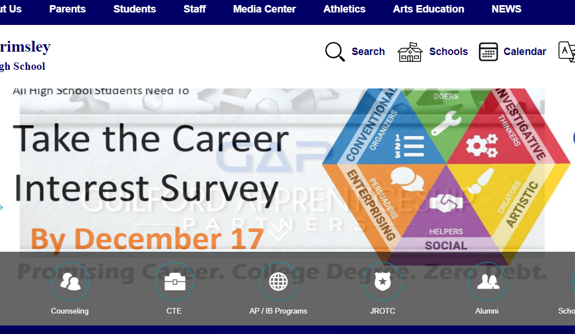
Acceptance Guidelines
•Link to the application located on Grimsley’s website (on IB page)
•Only students who would attend Grimsley, Dudley, Western, and Northwest are eligible to apply for the Grimsley IB Programme.
**GCS will send out notifications to all families.**

Slide 8
What does it look like at Grimsley?
Ninth Grade Year
1 | Honors English I
2 | Math: (Honors) Math II, (Honors) Math III
3 | Honors Civics and Economics, AP US Government & Politics
4 | Honors Biology
5 | World Language: Spanish, French, Latin, ASL (Level 1, 2, or 3 based on placement)
6 | Health and PE
Tenth Grade Year
1 | Honors English II
2 | Math: (Honors) Math III, (Honors) Pre-Calculus, or (Honors) AFM
3 | Honors Economics & Personal Finance*, AP European History
4 | Honors Chemistry
5 | World Language: Spanish, French, Latin, ASL (2, 3, or 4 based on placement)
6 | AP Music Theory (if Music HL track) AP Government AP Human Geography or Honors Elective
7 | Elective: Fine Arts or Honors Environmental Science*
Online Possibilities
Honors Environmental Science
Honors Math (based on student math progression)
*Honors Economics & Personal Finance – summer before/after 10th grade year

Slide 9
Ib courses currently offered at Grimsley
Group 1: Studies in Language and Literature | Group 2: Language Acquisition | Group 3: Individuals and Societies | Group 4: Sciences | Group 5: Mathematics | Group 6: The Arts**
IB English HL (jr. and sr. years) | -IB Spanish SL/HL -IB French SL -IB Latin SL | IB History of Americas SL/HL (jr. and sr. years) -IB Philosophy SL/HL -IB Psychology SL/HL -IB Environmental Systems & Societies SL* | -IB Biology SL/HL -IB Chemistry SL/HL -IB Environmental Systems & Societies SL* | -IB Math Applications SL -IB Mathematics HL | -IB Visual Art SL/HL -IB Theater SL/HL -IB Film SL/HL -IB Music SL/HL
**Arts: May be omitted for a second science, language acquisition, or individuals and society
* Interdisciplinary-counts for one

Slide 10
Grimsley IB Students
-Diverse
-World Travelers—many study abroad
-Attend universities in North Carolina, out of state (including Ivy League universities), and out of the country
-Some of the current colleges: Duke, Brown, Yale, NYU, UVA, Emory University, Lehigh University, NC A&T, UNC-CH, NC State, Wake Forest, Davidson College, Temple University
-Have received the Morehead Scholarship, the Robertson Scholarship, the BN Duke Scholarship, the Park Scholarship, the Jefferson Scholarship, and many others
-Are involved in their communities and campuses
-Are varsity, junior varsity, and club athletes
-Participate in the visual and performing arts on their campuses
-Participate in student government
-Receive global internships

Slide 11
Questions? BARNArR@gcsnc.com southes2@gcsnc.com Thanks for your time!

